Slide 1


Slide 2


Emotional Intelligence Activities
& Exercises
Go to next page
Notes:
Emotional Intelligence Activities & Exercises

Slide 3
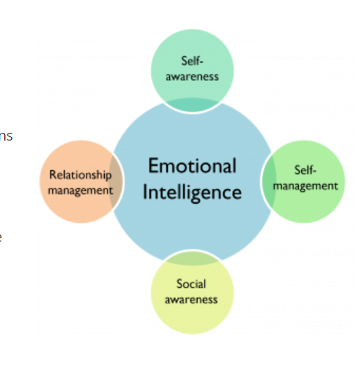
What are Emotional Intelligence Activities and Exercises?
As the name suggests, emotional intelligence activities and exercises are attempts to build, develop, and maintain one’s emotional intelligence, often called EI or EQ for Emotional Quotient.
Many people are interested in improving their EI, for a variety of reasons.

Slide 4
Some of the most common reasons to work on your EI include:
Wanting to succeed in a leadership role;
Trying to fit in with a new organization or new team;
Attempting to branch out of your network and make new friends or contacts;
Starting a new business and wanting to improve your customer service.

Slide 5
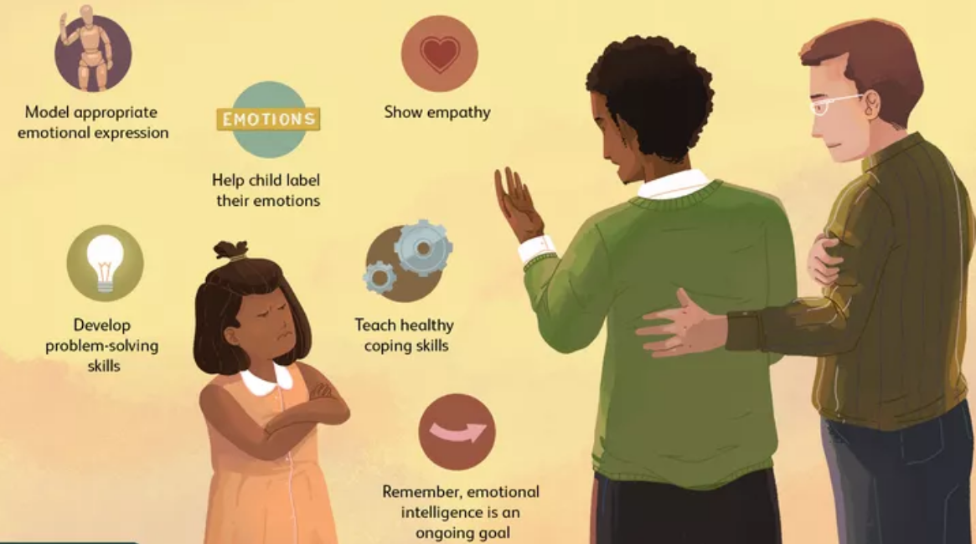
Tips for Using Emotional Intelligence Tools
Whether you’re looking to build your own emotional intelligence, encourage its development in your children or students, or trying to boost your team’s or organization’s EQ, there are many activities, tools, and resources you can use.

Slide 6
Tips for Enhancing Your Own Emotional Intelligence
If your goal is to boost your own emotional intelligence or help your clients boost their emotional intelligence (e.g., any EI work on an individual level), keep these seven tips in mind:
Reflect on your own emotions;
Ask others for perspective;
Be observant (of your own emotions);
Use “the pause” (e.g., taking a moment to think before speaking);
Explore the “why” (bridge the gap by taking someone else’s perspective);
When criticized, don’t take offense. Instead, ask: What can I learn?
Practice, practice, practice (Bariso, 2016).

Slide 7
Tips for Enhancing the Emotional Intelligence of Teams
If you’re looking to enhance your team’s emotional intelligence, keep these 7 tips in mind:
Have a ring leader;
Identify team members’ strengths and weaknesses;
Spark passion;
Build team norms;
Develop creative ways to manage stress;
Allow team members to have a voice;
Encourage employees to work and play together (Rampton, n.d.).

Slide 8
3 Exercises for Developing and Improving EI
These three exercises are meant to help individuals build their emotional intelligence and they are particularly helpful for leaders who want to boost their EI/EQ.
Emotional Intelligence Assessment for Leaders
Temperament Analysis
.Be the Fog (Regulate Your Emotions)

Slide 9
1. Emotional Intelligence Assessment for Leaders
This activity consists of 10 descriptions of vision-killing behaviors that a leader may engage in, and a scale upon which to rate your own engagement in each behavior from ‘very seldom’ to ‘very often.’
Treating people badly⁠—such as not showing people they care, forgetting to say thank you, not respecting people, not making people feel valued;
Living by the adage “Do as I say, not as I do,” and not setting good examples;
Focusing on too many things at once;
Pushing too hard on the task and forgetting the people;
Not giving clear direction;

Slide 10
Giving inconsistent direction;
Not taking responsibility for failure;
Focusing on the detail and forgetting to tell the “whys” or the big picture;
Showing little or no personal commitment to the vision;
Allowing people who aren’t performing the job to remain.
If you find yourself frequently engaging in these behaviors, that’s a good indication that your leader EQ is low. Pay close attention to the three behaviors you engage in the most often and commit to working on reducing or removing those behaviors entirely

Slide 11
2. Temperament Analysis
To get started, keep in mind that our temperament is made up of tendencies and feelings that are influenced by four factors or parameters:
To give this activity a try, get started with the temperament questionnaire:
Describe your temperament with three adjectives. Choose the ones that describe you best.
Suggest three adjectives that others use to describe your temperament.
Go through each of the adjectives identified in the above two questions and see if each one is because of (or how much each one is driven by) Genetic Inheritance, Physical Attributes, Life Experiences, or Environmental Conditions.
How does each of the temperamental factors affect you on a personal level?
How does each of the temperamental factors affect you on a leadership role level?
Which of these factors do you want to change and why?

Slide 12
3. Be the Fog (Regulate Your Emotions)
It can be very difficult for many of us to accept criticism, especially if receiving criticism provokes strong emotions. This simple exercise will help you “be the fog” and learn how to regulate and modulate your emotions in a difficult situation.
To give this activity a try, get started with the temperament questionnaire:
For example, if someone tells you something like:
“You just don’t understand.”
“You are lazy.”
“You are always late.”
“You don’t feel responsible.”
Respond with:
“Yes, I just don’t understand.”
“Yes, I am lazy sometimes.”
“Yes, I was late.”
“Yes, I just don’t take responsibility.”

Slide 13
Emotional Intelligence Group Activities
If you’d like to help a group work on building their EQ or work on your own EQ in a group setting, you’re in luck!
There are tons of group activities focused on developing, enhancing, and maintaining your emotional intelligence.
4. Accepting Your Emotions
5. Making Eye Contact
6. If You Knew…

Slide 14
Accepting Your Emotions
You’ll need a group of people for this activity, but you could also modify it to work with just one pair. Here’s how to do it:
Divide your group into pairs and have them sit far enough away from the other pairs to get a sense of privacy.
Have each pair decide who will go first.
Tell the group members that they will each have a chance to share an experience where they felt like a victim. Once one partner has explained the experience, they should explain how they felt as a result of their experience in as much detail as possible, thinking about their specific feelings at the moment and how it impacted them afterward.
Allow 15 minutes or so for the first partner to share and for the pair to discuss, have them switch roles.

Slide 15
Making Eye Contact
If you are running this activity in a group, bring everyone back together and have a group discussion using questions like these:
What did you think first when you were told to share a difficult experience with another person?
How did you manage to share it? How did you feel when you shared it with someone else?
How did you feel after acknowledging and accepting your emotions?
Does this exercise help with accepting how certain experiences make us feel and that it is okay to feel a certain way after negative experiences?
Did you feel more at peace after accepting your emotions generated by your experience?
Would you consider using this exercise to evaluate and acknowledge your emotions after negative experiences?

Slide 16
If You Knew…
Start with a flip chart or a whiteboard with these questions on it:
What was the happiest moment in your life?
What was your unhappiest experience in life?
What motivates you to get up in the morning?
What do you use your money for?
Who is the most important person in your life?
Describe your best friend.
At the end, pose these questions to get a good discussion started:
Did this activity help you to know your team members better?
Did it help explain certain behaviors and actions of co-workers?
Would it be helpful to share some personal information with those that we work closely with?
Did this session help clear up some of the misunderstandings between team members?

Slide 17
Question :
Some of the disadvantages of conducting tests include: I. Reliable II. Wrong Use III. Fear of Exposure
○ I and II only
○ II and III only
○ I and III only
○ I, II, and III
Notes:
Ans:b
Reliable - This usually means that tests can be trusted to give accurate results, so it might not be a disadvantage.
Wrong Use - This could be a disadvantage if tests are misinterpreted or misused.
Fear of Exposure - This can also be a disadvantage, as people might be afraid of the results being shared or judged.
Based on this analysis, the most likely answer would be II and III only, since "Reliable" doesn't seem to fit as a disadvantage.

Slide 18
Question :
Some of the advantages of tests which are conducted for recruiting include: I. Improper Assessment II. Uniform Basis
○ I. True II. True
○ I. True II. False
○ I. False II. True
○ I. False II. False
Notes:
Ans:
Improper Assessment - This suggests that tests may not accurately measure a candidate's abilities, which is generally considered a disadvantage, not an advantage.
Uniform Basis - This means that tests provide a consistent way to evaluate all candidates, which is an advantage.
So, the correct evaluation would be:
I. False (because improper assessment is not an advantage)
II. True (because uniform basis is an advantage)
Therefore, the correct choice is: I. False II. True.

Slide 19
Question :
What is the information collected from you in a personality test called?
○ Personal result
○ Personified data
○ Personality profile
○ Personal data
Notes:
Ans: c
The information collected from you in a personality test is called a Personality profile.
So, the correct choice is:
Personality profile

Slide 20
Question :
Which of the following is NOT a general skills test during an interview?
○ Programming languages
○ Software frequently used in that particular field
○ Physical test
○ Scenario-based test
Notes:
Ans: c
Physical test

Slide 21
Question :
Psychometric Analysis is relevant to employability because it allows the recruiter to measure several parameters: I. Intelligence II. Demotivation III. Critical reasoning
○ I and II only
○ II and III only
○ I and III only
○ I, II, and III
Notes:
Ans:c
I. Intelligence: Yes, this is often measured to assess a candidate's ability to learn and adapt.
II. Demotivation: This is not typically a parameter measured in psychometric tests.
III. Critical reasoning: Yes, this is relevant as it assesses problem-solving and decision-making skills.
Based on this analysis, the correct choice would be I and III only.

Slide 22
Question :
An employer seeks the following from an employee in his personality test EXCEPT
○ Can do the job
○ Will do the job
○ Will fit in
○ Can overdo the job
Notes:
Ans: d
Can do the job - This means the employee has the skills.
Will do the job - This means the employee is willing to work.
Will fit in - This means the employee will get along with the team.
Can overdo the job - This suggests doing more than necessary, which is not typically a desired trait.
The answer is "Can overdo the job" because it doesn't align with what an employer usually seeks in a personality test. They want someone who can do the job well, not someone who might take it too far.

Slide 23
Question :
Which of the following is not a trait of a personality test?"
Openness
Conscientiousness
Extraversion
Disagreeableness
Notes:
Ans: d
The other three options—Openness, Conscientiousness, and Extraversion—are part of the Big Five personality traits. Disagreeableness is often referred to as a negative aspect of agreeableness, but it's not typically listed as a separate trait.

Slide 24
Question :
What is the first step in choosing your ideal skill assessment testing tool?
Defining goals and needs
Research the market
Define the skills not required
Define the characteristics which are not needed
Notes:
Ans: Defining goals and needs.
Explanation: Before diving into market research or other steps, it's crucial to have a clear understanding of your goals and what you need from a skill assessment tool. This helps guide your decision-making process effectively. Let me know if you'd like further assistance!

Slide 25
Question :
How are skill tests helpful in the hiring process?
To make accurate decisions
To ask questions
To make candidates nervous
To help students financially
Notes:
Ans: To make accurate decisions
Explanation: Skill tests are designed to evaluate candidates' abilities objectively, ensuring that hiring managers can make informed and accurate decisions based on the results. The other options do not align with the core purpose of skill assessments. Let me know if you need further assistance!

Slide 26

THANK YOU

